Slide 1
PhishNinja
PIP104 PROFESSIONAL PRACTICE-II
VIVA-VOCE
Batch Number: 48
Roll Number | Student Name
20201CCS0131 | Mr. Umraz Khan
20201CCS0070 | Mr. Samrudh D Yash
20201CCS0132 | Mr. Lenin E
20201CCS0046 | Mr. K Rehan
20201CCS0063 | Mr. Jonathan R
Under the Supervision of,
Mr. Praveen Pawaskar
Assistant Professor CSE
School of CSE&IS
Presidency University

Slide 2
Introduction
As the prevalence of online communication and transactions continues to rise, the threat of phishing attacks has become a critical concern for individuals and organizations alike. Phishing attacks exploit human vulnerabilities by tricking users into divulging sensitive information, such as login credentials and financial details. This presentation introduces an advanced phishing detection algorithm designed to enhance cybersecurity measures and mitigate the risks associated with phishing.
algorithm combines machine learning techniques with feature engineering to create a robust and adaptive system for detecting phishing attempts. It leverages a diverse set of features, including URL analysis, content inspection, and behavioral patterns, to comprehensively evaluate the legitimacy of a given webpage. The machine learning model is trained on a large dataset of known phishing and legitimate websites, enabling it to learn and generalize patterns indicative of phishing behavior.
Key components of the algorithm include:
Phishing Database Check: The algorithm checks if the provided URL exists in the daily updated phishing database and flags accordingly.
URL Analysis: The algorithm evaluates the structure and components of URLs to identify suspicious patterns, such as misspelled domain names or the presence of subdomains commonly associated with phishing.

Slide 3
Literature Review
Author | Year | Method | Review
Yohan et al. | 2023 | Machine Learning Approach | The Model developed classifies Phishing sites
RamiM et al. | 2015 | Blacklisting and white listing website approach | Proposes two discrete lists to classify websites
Munmun et al. | 2023 | Authentication scheme for detecting phishing by users. | Proposes various Models for better prevention of data. (Network and Security)
Piers et al. | 2021 | Research questions and hypothesis development | Impact of threat appraisals and coping appraisals
Zainab & Chaminda | 2021 | Email and URL detection | Focuses on the different aspects of phishing and its effects
Muhammet & Zahit | 2018 | Simulator called "The Anti Phishing Simulator | It is developed to check the text content and provides URL filters
MANUEL et al. | 2022 | Machine Learning Methods and Deep learning approaches. | Inferences were drawn using datasets and phishing detection models.
Dina et al. | 2023 | Data mining models | Given time constraints the most efficient method for identifying phishing websites is to analyze the features of the URL.
Christopher et al. | 2018 | Boosting Bases Classification and Baseline Comparison | Developed a system called SAFe-PC for detection
JIAN MAO1 et al. | 2017 | Page Component Similarity | Proposed Phishing-Alarm based on CSS features of web pages
Sujata et al. | 2018 | Page based | Type based Domain based and word based features Identified several new and generic features for identifying phishing URLs
Hossein et al. | 2023 | Using Adversarial Autoencoder Data Synthesis to Improve Machine Learning and Deep Learning. | Developed AAE and WGAN based technique for generating data that mimic phishing and genuine websites
Moruf & Khin | 2020 | Deep learning algorithms | Differentiating URLs by using the CNN and LSTM

Slide 4
Research Gaps Identified
Polymorphic phishing involves constantly changing elements like URLs, code snippets, or email content, making detection challenging for analytical tools due to rapid variations.
Obfuscation techniques are employed to hide malicious code, complicating analysis for traditional tools. Fileless phishing attacks don't rely on traditional malware files, requiring advanced techniques to analyze as they exploit legitimate processes or scripting languages.
Phishing attempts often mimic legitimate services, making it difficult to distinguish between malicious and genuine requests. Encrypted communication is increasingly used in phishing attacks, posing a significant challenge for analysis tools trying to decipher hidden malicious payloads.

Slide 5
Proposed Methodology
Multi-layered approach for robust phishing detection
Database Verification: Flags threats by checking URLs against a daily updated open-source database
Components: Phishing Database Verification
Validates URLs against an updated repository of known phishing instances
URL Analysis: Evaluates URL structure, identifying suspicious patterns
Content Inspection: Uses NLP for deep content analysis to identify phishing indicators
Behavioural Patterns: Monitors user interactions for anomalous behavior
Machine Learning Model: Utilizes a diverse dataset for webpage classification based on various features.
Machine Learning Model: Leverages a dataset with details from 11,000+ websites.
Gradient Boosting Classifier: Ensemble learning algorithm for classification and regression tasks.
Utilizes weak learners, optimizing with gradient descent and controlling robustness.

Slide 6
Objectives
Real-Time Content Analysis: Uses machine learning to analyse webpage content for phishing patterns.
URL Analysis: Scrutinizes URLs for suspicious patterns, especially those mimicking legitimate sites.
Heuristic Evaluation: Uses heuristics to assess phishing threats based on criteria like HTTPS and domain legitimacy.
Blacklist Referencing: Cross-references URLs with updated blacklists of confirmed phishing sites.
User Education and Alerts: Informs users about phishing risks, providing alerts when potential threats are detected.
Privacy-Preserving Techniques: Ensures user data privacy with techniques like differential privacy during analyses.

Slide 7
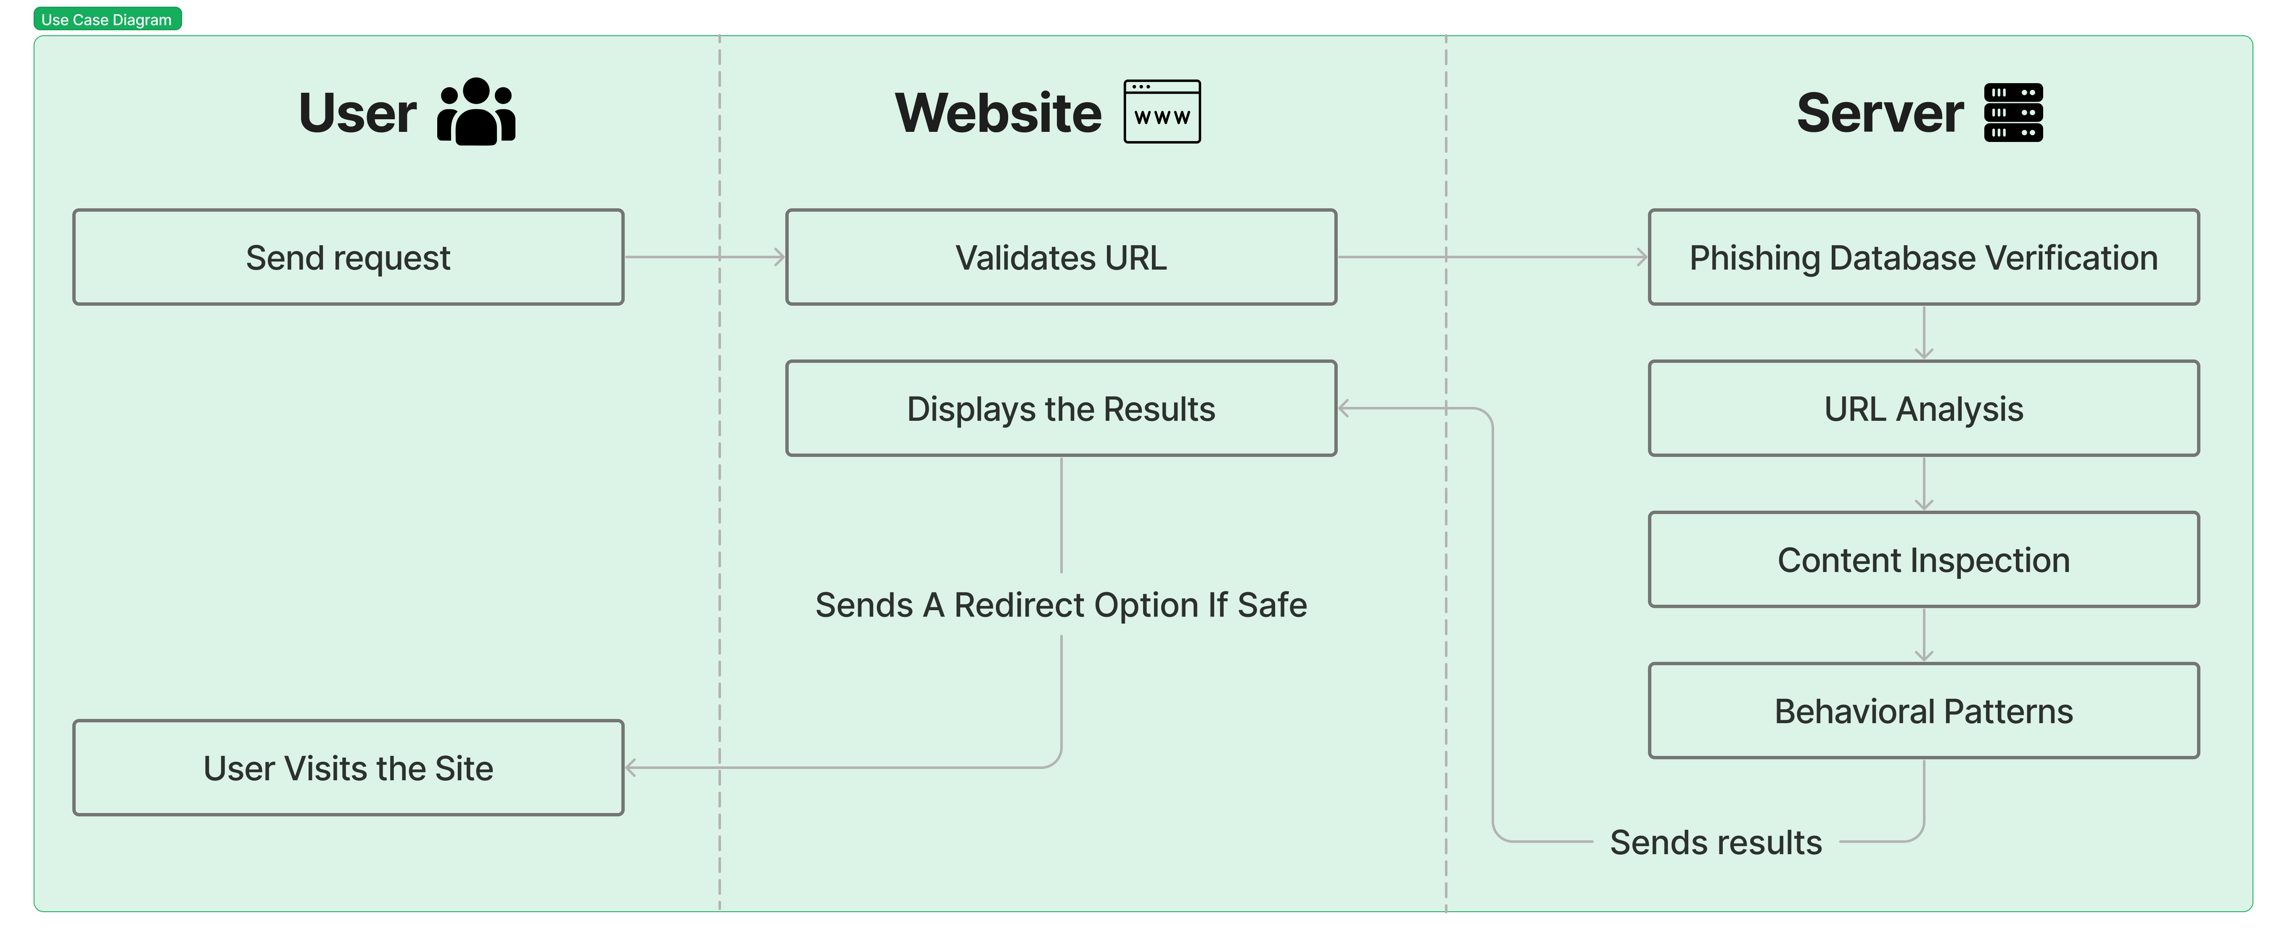
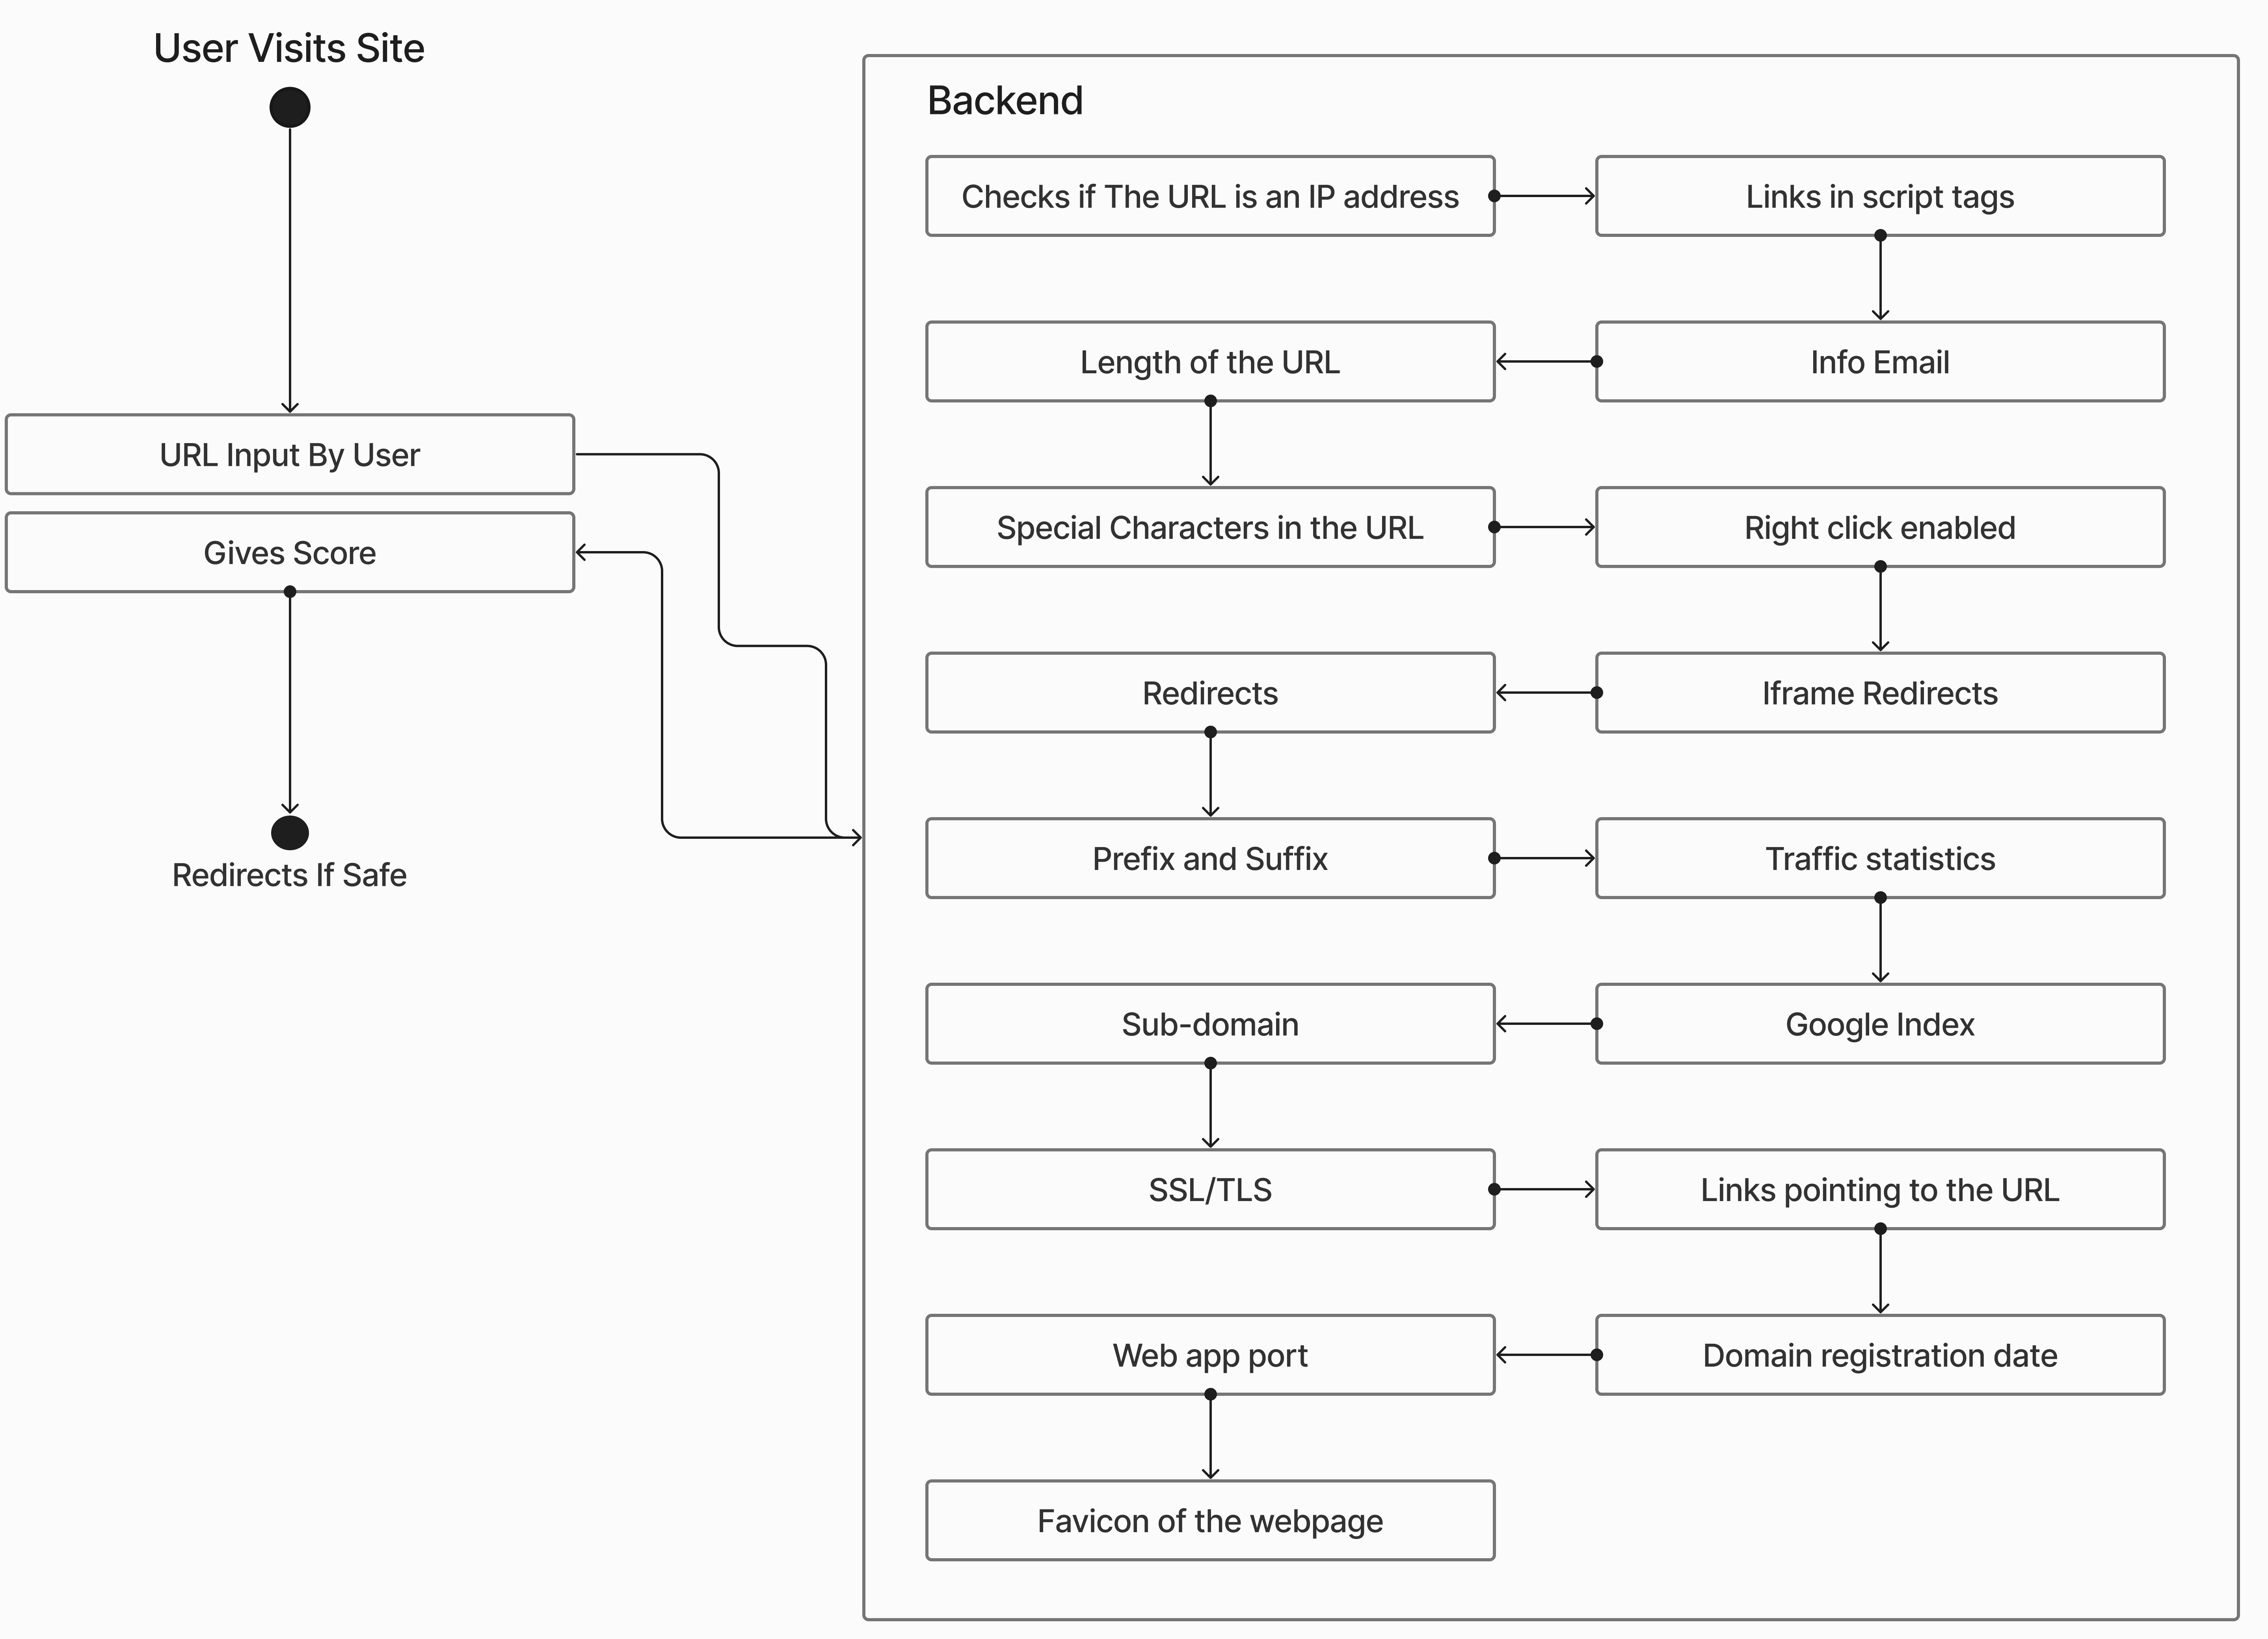
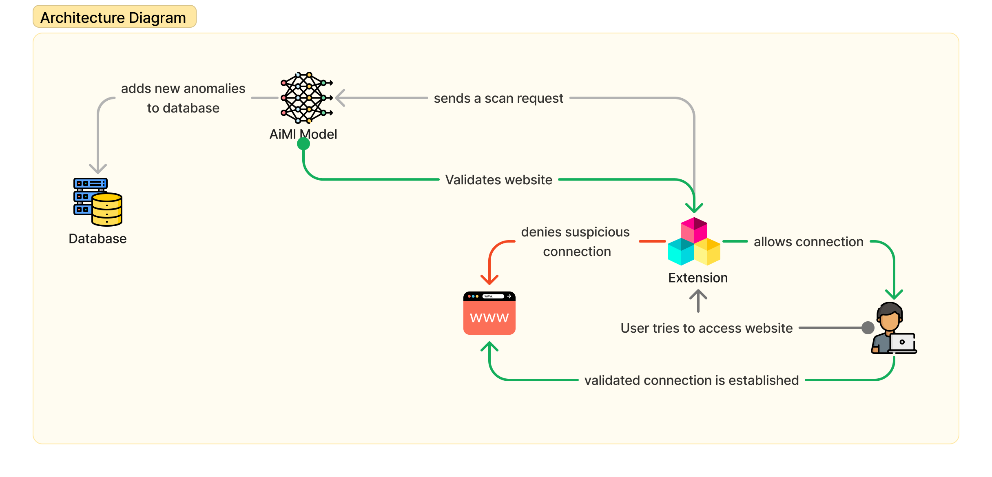
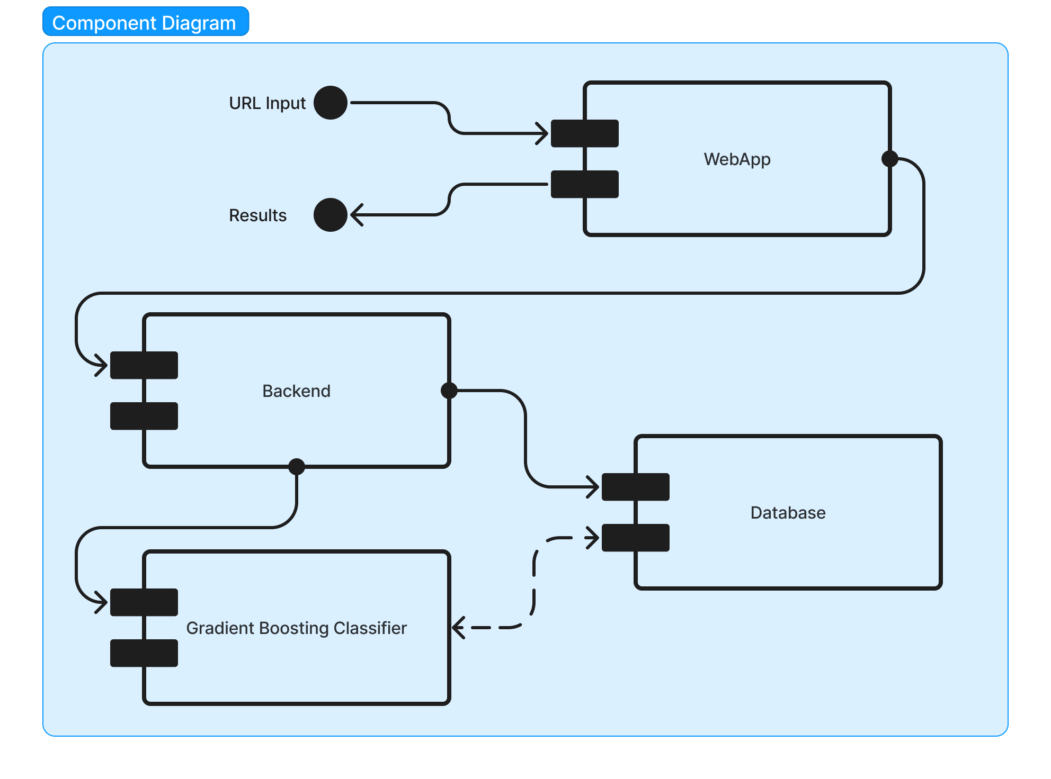
System Design & Implementation

Slide 8
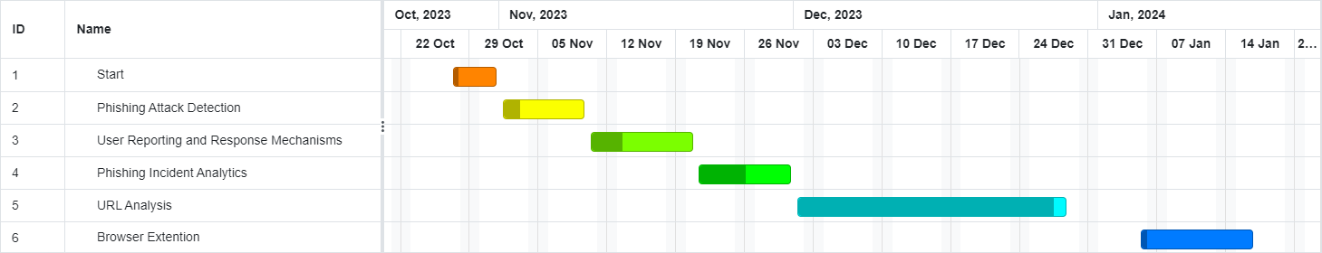
Timeline of Project

Slide 9
Outcomes / Results Obtained
Phishing Detection Application Highlights:
User-Friendly Interface: A transparent, step-by-step interface ensures a seamless and credible phishing detection experience.
Encouraging Vigilance: Actively engages users, fostering a heightened sense of caution in their online interactions.
High Accuracy Rate: Demonstrates an exceptional accuracy rate in identifying phishing websites, instilling robust user confidence.
Safeguards Against False Alarms: Implements measures to prevent disruptions to legitimate website access, prioritizing user trust and experience.
Optimized Algorithms: Utilizes resource-efficient algorithms, enabling swift and precise phishing detection without compromising system performance. This emphasis on efficiency enhances user experience while maintaining a high level of security.

Slide 10
Conclusion
Critical Line of Defense: The phishing URL detection tool serves as a crucial defense mechanism in online security, acting as a bulwark against a diverse range of threats encountered by users.
Identification and Prevention: The fundamental purpose of the tool is to identify and prevent access to potentially malicious URLs, safeguarding users from falling victim to phishing attacks.
Sophisticated Algorithm: The tool employs a sophisticated algorithm that combines various checks, enhancing the robustness of its protective capabilities.
URL Parsing: A key element within the algorithm is URL parsing, a process that dissects the components of a web address to discern its structure.
Extraction of Critical Information: URL parsing enables the tool to extract critical information such as domains, subdomains, paths, and query parameters from the web address.
Detection of Anomalies: The extracted information aids in the detection of anomalies that might indicate a phishing attempt, allowing the tool to proactively identify potential threats.
Shielding Users: By understanding the structure of URLs and detecting irregularities, the tool acts as a shield, preventing users from accessing and falling victim to potentially harmful phishing URLs.
Comprehensive Protection: The algorithm's amalgamation of checks and the parsing process contribute to the tool's comprehensive protection, ensuring a multi-faceted approach to defending against phishing attacks.

Slide 11
References
Akarshita Shankar, Ramesh Shetty and Badari Nath - A Review on Phishing Attacks, International Journal of Applied Engineering Research ISSN 0973-4562 Volume 14, Number 9 (2019) pp. 2171-2175.
Gaurav, Madhuresh Mishra, Anurag Jain - Anti- Phishing Techniques: A Review, International Journal of Engineering Research and Applications (IJERA), vol. 2, pp. 350-355, April – 2012.
Information ManagementComputer Security Vol. 20 No1, 2012 pp. 18-28 Emerald Group Publishing Limited 0968-5227 DOI 10.1108/09685221211219173
Madhusudhanan Chandrasekaran, Krishnan Narayanan and Shambhu Upadhyaya - Phishing E- mail Detection based on Structural Properties, IEEE, November 2015.
Yi-Shin Chen, Huei-Sin Liu, Yi-Hsuan Yu and PangChieh Wang, Detect Phishing by Checking Content Consistency, IEEE, 2017.
M. Bhattacharya, S. Roy, S. Chattopadhyay, A. K. Das and S. S. Jamal, ”ASPA-MOSN: An Efficient User Authentication Scheme for Phishing Attack Detection in Mobile Online Social Networks,” in IEEE Systems Journal, vol. 17, no. 1, pp. 234-245, March 2023, doi:10.1109/JSYST.2022.3168234.
Bayl-Smith, P., Taib, R., Yu, K. and Wiggins, M. (2022), ”Response to a phishing attack: persuasion and protection motivation in an organizational context”, Information and Computer Security, Vol. 30 No. 1, pp. 63-7
https://doi.org/10.1108/ICS-02-2021-0021.8. M. S´anchez-Paniagua, E. F. Fern´andez, E. Alegre, W. Al-Nabki and V. Gonz´alez-Castro, ”Phishing URL Detection: A Real-Case Scenario Through Login URLs,” in IEEE Access, vol. 10, pp. 42949-42960, 2022, doi: 1109/ACCESS.2022.3168681.
D. Jibat, S. Jamjoom, Q. A. Al-Haija and A. Qusef, ”A Systematic Review: Detecting Phishing Websites Using Data Mining Models,” in Intelligent and Converged Networks, vol. 4, no. 4, pp. 326-341, December 2023, doi: 10.23919/ICN.2023.0027
Alkhalil Z, Hewage C, Nawaf L and Khan I (2021) Phishing Attacks: A Recent Comprehensive Study and a New Anatomy. Front. Comput. Sci. 3:563060. doi:10.3389/fcomp.2021.563060.
C. N. Gutierrez et al., ”Learning from the Ones that Got Away: Detecting New Forms of Phishing Attacks,” in IEEE Transactions on Dependable and Secure Computing, vol. 15, no. 6, pp. 988-1001, 1 Nov.-Dec. 2018, doi:10.1109/TDSC.2018.2864993.
J. Mao, W. Tian, P. Li, T. Wei and Z. Liang, ”Phishing- Alarm: Robust and Efficient Phishing Detection via Page Component Similarity,” in IEEE Access, vol. 5, pp. 17020- 17030, 2017, doi: 10.1109/ACCESS.2017.2743528.
H. Shirazi, S. R. Muramudalige, I. Ray, A. P. Jayasumana and H. Wang, ”Adversarial Autoencoder Data Synthesis for Enhancing Machine Learning-Based Phishing Detection Algorithms,” in IEEE Transactions on Services Computing, vol. 16, no. 4, pp. 2411-2422, 1 July-Aug. 2023, doi:10.1109/TSC.2023.3234806.
Adebowale, M.A., Lwin, K.T. and Hossain, M.A. (2023), ”Intelligent phishing detection scheme using deep learning algorithms”, Journal of Enterprise Information Management, Vol. 36 No. 3, pp. 747-766. https://doi.org/10.1108/JEIM-01-2020-0036.
E. Zhu, Z. Chen, J. Cui and H. Zhong, ”MOE/RF: A Novel Phishing Detection Model Based on Revised Multiobjective Evolution Optimization Algorithm and Random Forest,” in IEEE Transactions on Network and Service Management, vol. 19, no. 4, pp. 4461-4478, Dec.2022, doi: 10.1109/TNSM.2022.3162885.

Slide 12
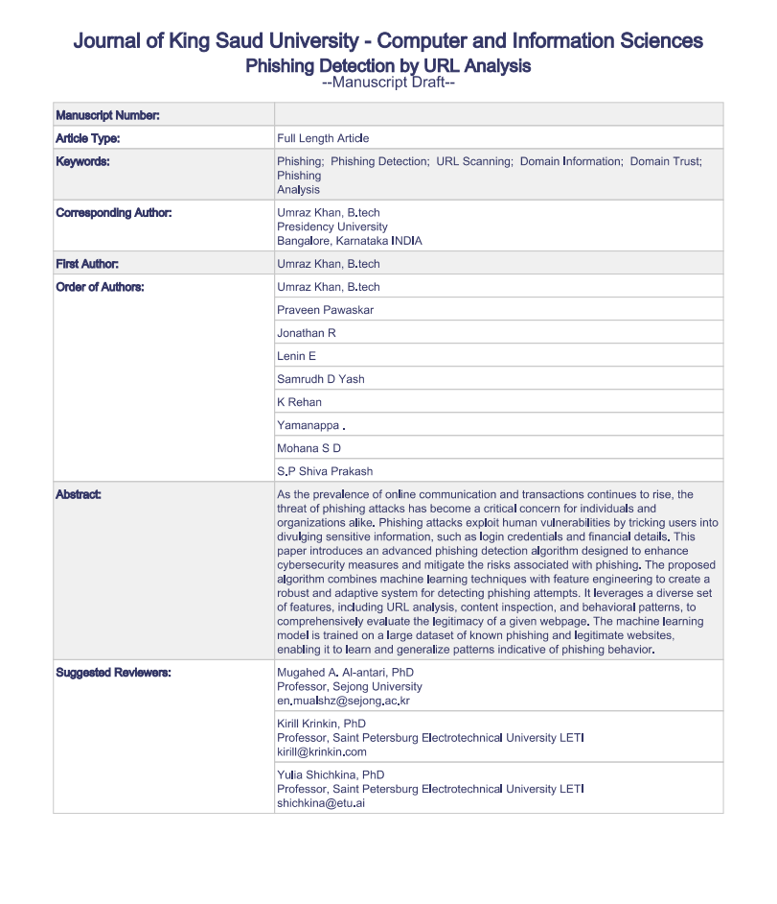
Publication Details

Slide 13

Thank You

